Slide 1
PRODUCT CATALOG
RR ENGINEERING WORKS SDN BHD
N0 . 23 , JALAN NAYU 2/4,PERINDUSTRIAN TAMPOI JAYA
81200 , JOHOR ,MALAYSIA
Mr. Bharathi Rajan
Tel: 07-232 9267 , Mobile : 016-724 4501 / 016-724 4502
Email: sales@rrengineeringservices.com

Slide 2
ABOUT US
Precision fabrication is the heartbeat of modern manufacturing, where every cut, weld, and polish is executed with meticulous attention to detail.
At RR Engineering we're not just a part of this industry; we're the artisans of precision, crafting components that elevate industries and redefine possibilities.
In a world where precision matters more than ever, trust
RR Engineering deliver excellence without compromise. Join us in redefining the standards of precision fabrication and shaping a world where perfection is the norm.

Slide 3
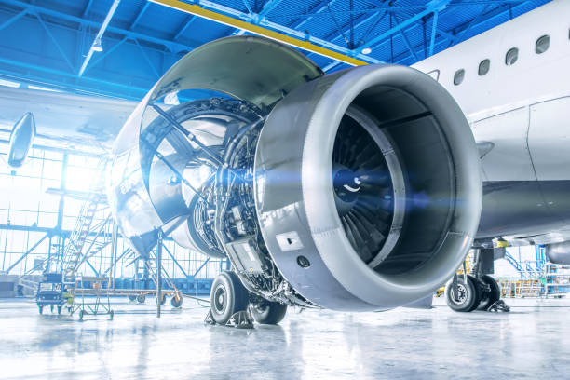
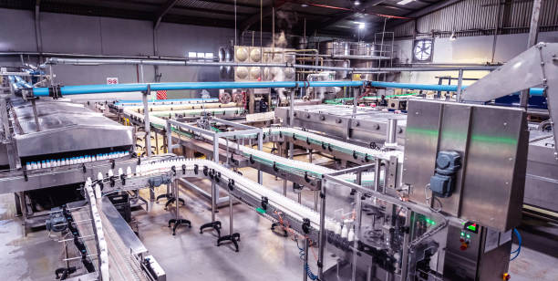
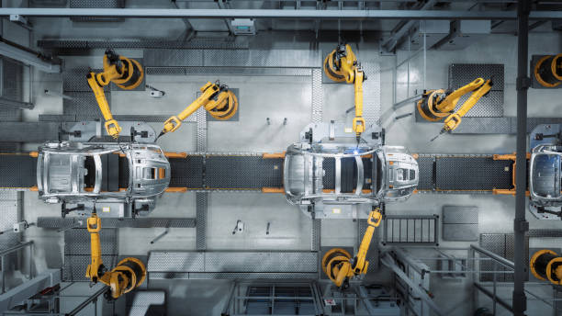
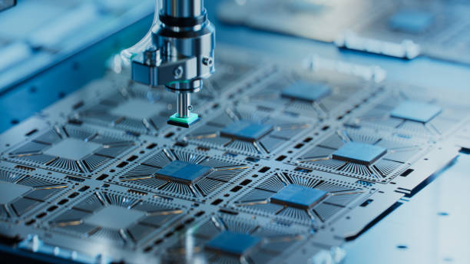
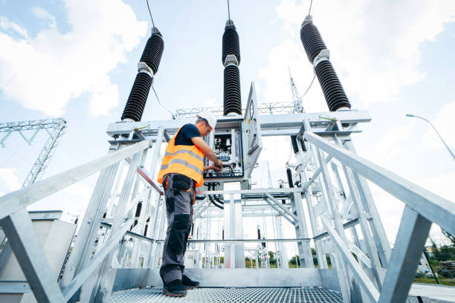
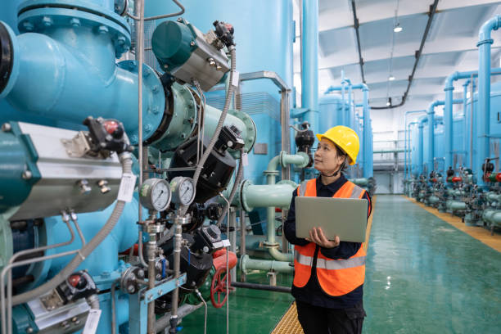
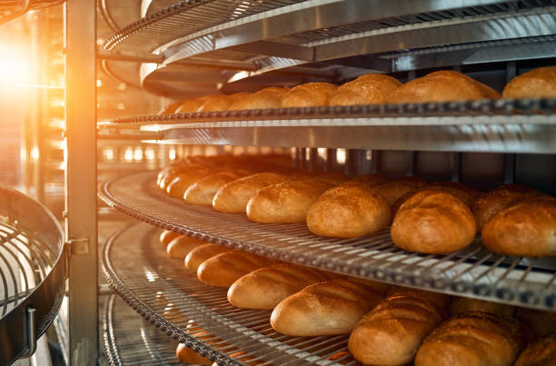
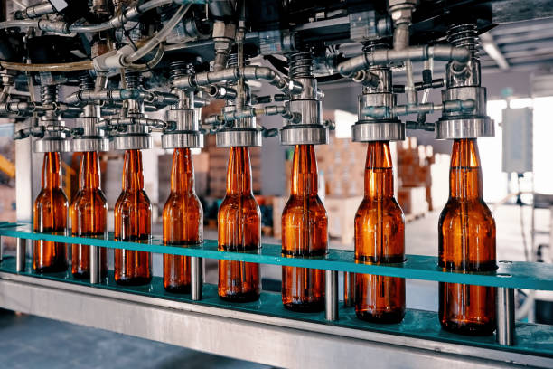
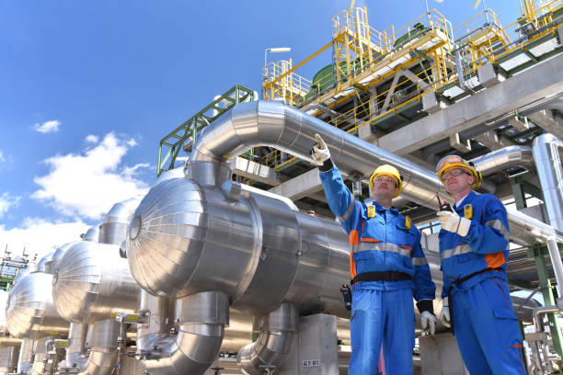
INDUSTRIES SERVING
AEROSPACE
AUTOMATION
AUTOMOTIVE
SEMICONDUCTOR
ELECTRICAL
LIQUID PROCESSING
FOOD PROCESSING
BEVERAGE PROCESSING
OIL & GAS

Slide 4
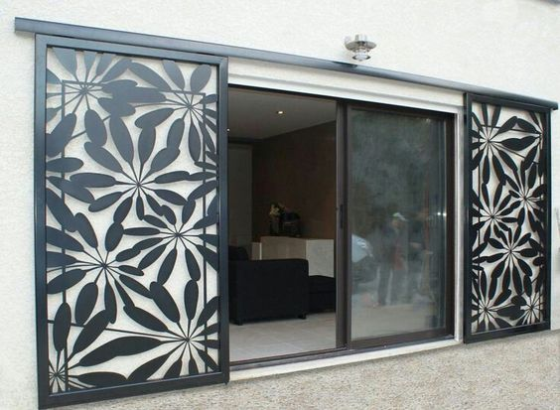
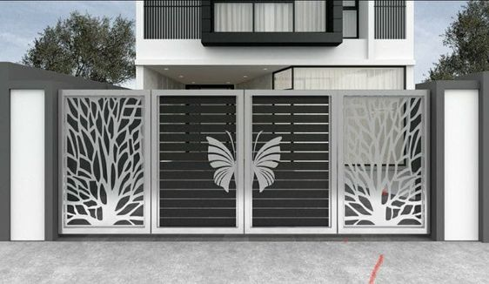
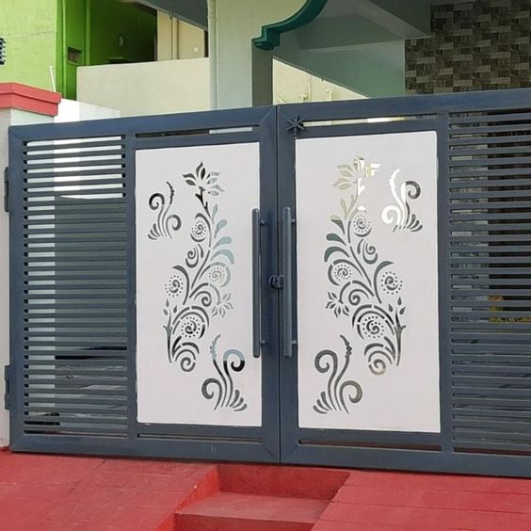
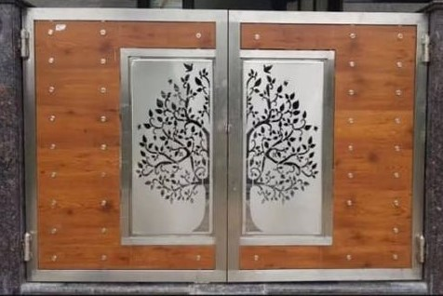
PRODUCT GALLERY- GATES

Slide 5
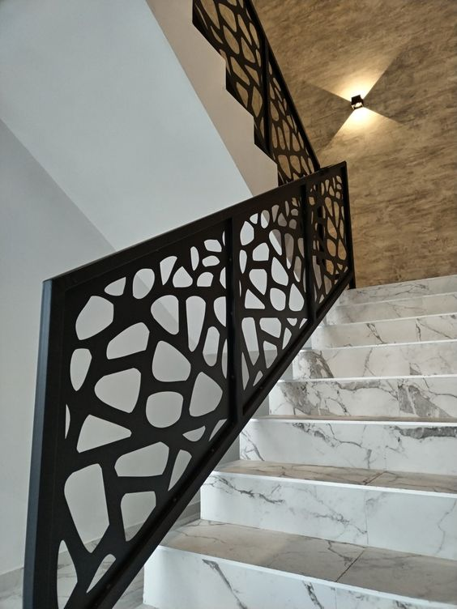
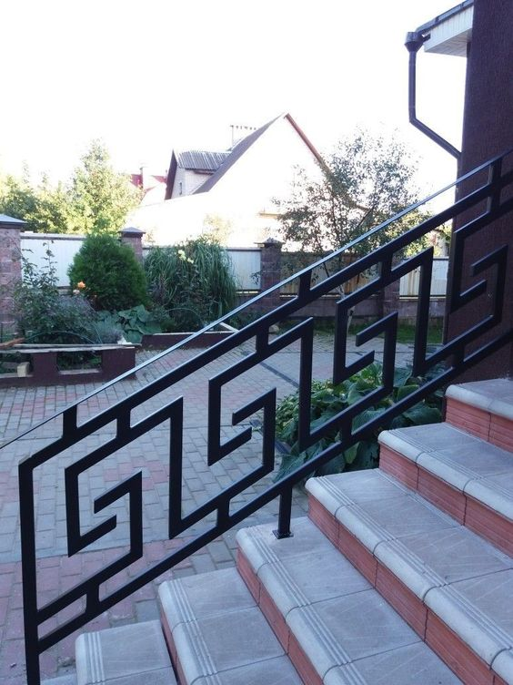
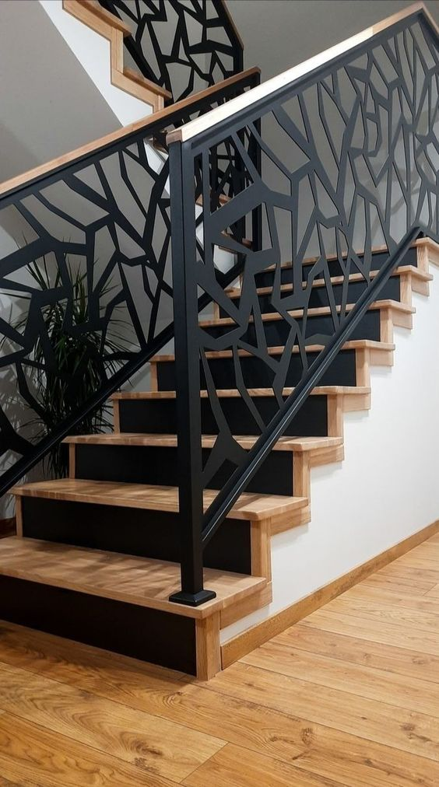
PRODUCT GALLERY- INTERIOR RAILS

Slide 6
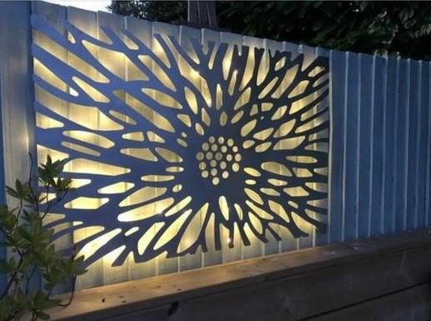
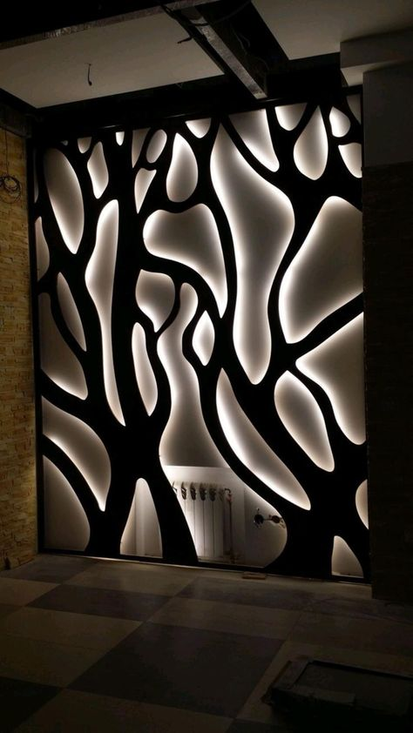
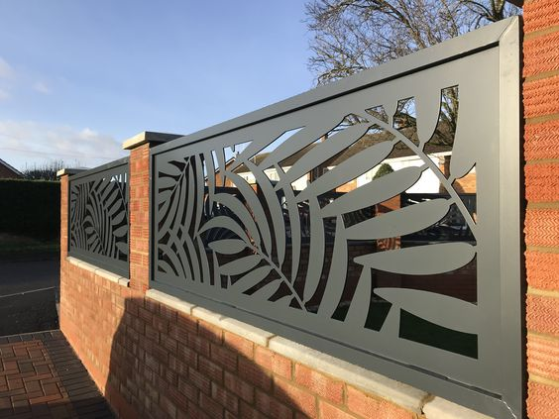
PRODUCT GALLERY- ART FENCE

Slide 7
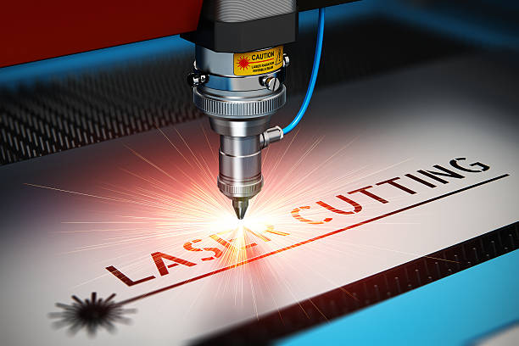
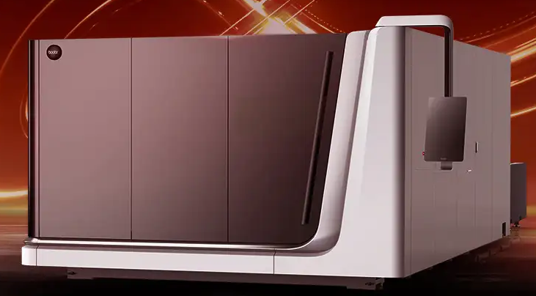
We are pioneers in Laser cut services , can Accomplish difficult Tasks , we facilitate with Bodor make 3Kw super scan Fiber Laser .

Slide 8
precision fabrication isn't just about cutting-edge technology; it's about understanding our clients' needs and surpassing their expectations. We collaborate closely with our partners, offering tailored solutions that address their unique challenges. From concept to completion, we're there every step of the way, providing unparalleled support and expertise.
we're not just shaping metal; we're shaping the future. Our commitment to innovation drives us to push the boundaries of what's possible, constantly seeking new techniques, materials, and processes to stay ahead of the curve. As industries evolve, so do we, ensuring that we remain at the forefront of precision fabrication.

Slide 9
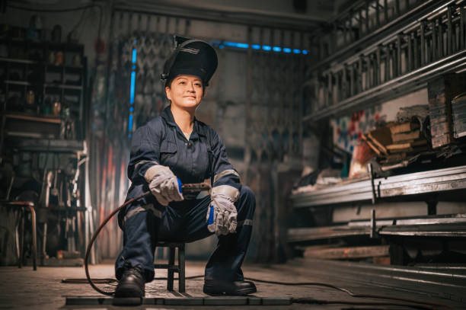
RR ENGINEERING WORKS SDN BHD
We would be delighted to have you join us in advancing welding technology.

